Slide 1

Data Interactive Notebook
Your Name
Class 8.4
Mrs Riksman
Term 1 Semester 1
1

Slide 2
Contents
Glossary
Page
Date
Description
Word
Description
4-5
6-7
8-9
4/3
6/3
9/3
17/3
Measures of Centre
Measures of Spread
Interpreting graphs and tables
Using frequency tables to construct a histogram

Slide 3
24
7
30
Title: Measures of Centre
Date: 4/3/15
EQ : Describe what is meant by mean, median and mode.
Question:
Notes:
The mean or average of a set of numbers is calculated by first adding all of the values together and then dividing by the number of values in the data set.
Mean = (sum of all the values)
(total number of values)
The median is the middle value when the values are written in ascending or descending order.
Remember ascending is from smallest to largest and descending is the reverse from largest to smallest.
If there are two middle values then the average of them is taken by adding them together and dividing it by two.
The most common value (that which occurs most frequently) is called the mode.
Describe how we calculate the mean of a set of data.
How do we find the median?
What do we do if there is more than one median?
The most frequent value becomes what measure of centre?
5

Slide 4
Activity : Maximum Monthly Temperatures for January 2015
Lets work together to calculate the mean.
Now lets order the temperatures from smallest to largest to calculate the mean.
Which temperature is most frequent in January?
30 | 29 | 30 | 31 | 34
26 | 26 | 32 | 31 | 32
29 | 27 | 36 | 31 | 28
36 | 30 | 30 | 30
41 | 33 | 27 | 34
35 | 35 | 39 | 38
31 | 30 | 37 | 38

Slide 5
Activity – Shoe sizes
Have you class write their shoe size on their white boards and raise them above their heads
Tally the number of each size.
Calculate:
Mean -
Median -
Mode –
Complete exercise 8D page 465 Q1-18
1 | 5 | 8
2 | 6 | 10
3 | 7 | 11
4 | 8 | 12

Slide 6
24
7
30
Title: Measures of Spread
Date: 5/3/15
EQ :Explain how to calculate range and interquartile range (IQR).
Question:
Notes:
The range of a set of data is calculated by subtracting the lowest number from the highest number.
Range = highest number – lowest number
Example:
Find the range for the following set of data
1,5,2,3,8,12,4 = 12 -1 = 11
What about if we have negative numbers in our data?
-6,-20,7,12, -24,19 = 19-(-24)
= 19 + 24
= 43
How do we determine range of a set of data?
7
5

Slide 7
Question:
Notes continued:
The interquartile range (IQR) can be found by
IQR = upper quartile (UQ) – lower quartile (LQ)
Placing the data in order from smallest to largest (ascending).
If there is an odd number of values remove the middle one.
Split the data into two equally sized groups.
The median of the lower half is called the lower quartile.
The median of the upper half is called the upper quartile.
Subtract the lower quartile from the upper quartile.
Example:
Find the interquartile range of the following set of data
1, 15, 8, 2, 13, 10, 4, 14
1, 2, 4, 8, 10, 13, 14, 15
N/A
1, 2, 4, 8 10, 13, 14, 15
2 + 4 = 6 ÷ 2= 3 LQ = 3
13 + 14 = 27 ÷ 2 = 13.5 UQ = 13.5
IQR = 13.5 – 3 = 10.5
Describe the 6 step process we use to determine the Interquartile Range of data
7
5

Slide 8
24
7
30
Title: Interpreting graphs and tables
Date: 10/3/15
EQ : Describe how we can use different types of graphs to represent data.
Question:
Notes:
Graphs and tables are the most commonly used ways to represent data that has been collected.
Types of graphs include:
Column graphs
Line Graphs
Histogram
Divided Bar Graphs
Pie Charts
Why do we use graphs and tables?
List 3 different types of graphs.
9
5

Slide 9
Question:
Notes continued:
Graphs should include the following:
A title
Labels on each axis (x and y)
A numbered scale
Legend (if needed)
What do you need to include when graphing?
9
5

Slide 10
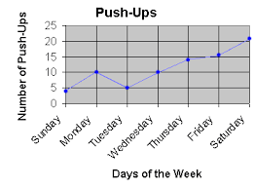
Activity :
Look at the following Graphs and make note of the features in each
Line Graph

Slide 11
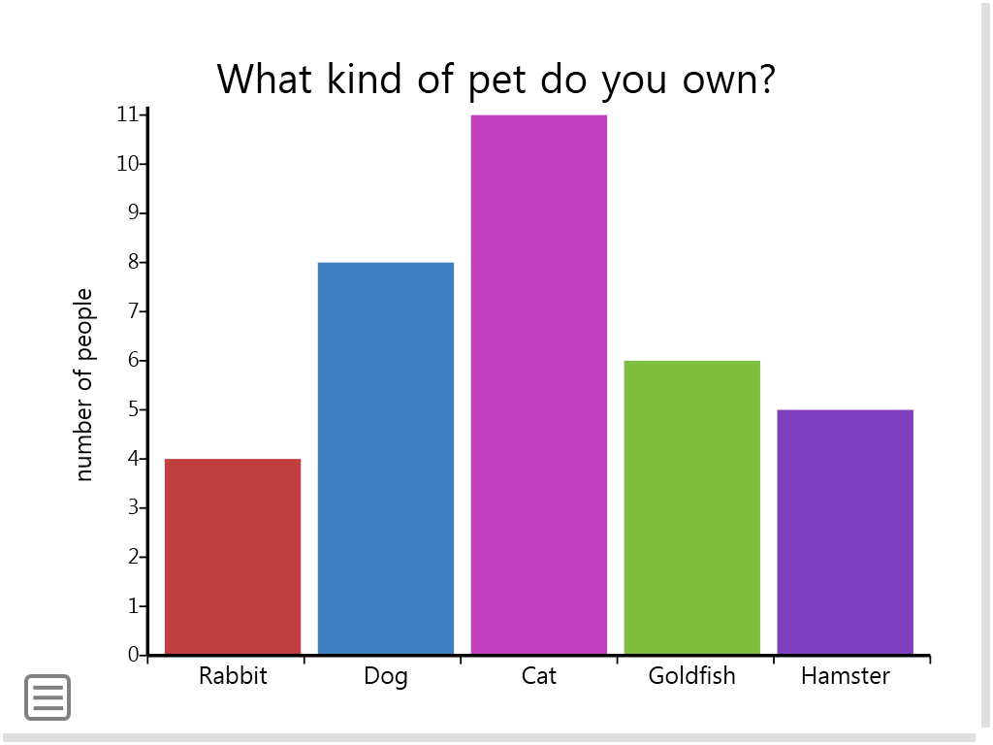
2) Bar Graph

Slide 12
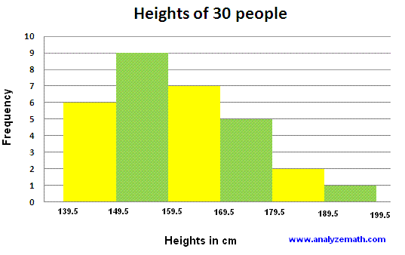
3) Histogram

Slide 13
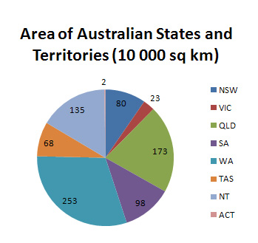
4) Pie Graph

Slide 14
24
7
30
Title: Using frequency tables to construct a histogram
Date: 17/3/15
EQ : Explain the process in constructing a histogram from a frequency table
Question:
Notes:
To make a frequency distribution table, first divide the numbers over which the data ranges into intervals of equal length. Then count how many data points fall into each interval.
Intervals (in dollars) | Frequency
0.50 - 0.99 | 4
1.00 - 1.49 | 7
1.50 - 1.99 | 3
2.00 - 2.49 | 3
2.50 - 2.99
3.00 - 3.49 | 2
3.50 - 3.99 | 1
Total | 20
11
5

Slide 15
Question:
Notes continued:
Making a Histogram Using a Frequency Distribution Table
A histogram is a bar graph which shows frequency distribution.
To make a histogram, follow these steps:
On the vertical axis, place frequencies. Label this axis "Frequency".
On the horizontal axis, place the lower value of each interval. Label this axis with the type of data shown (price of birthday cards, etc.)
Draw a bar extending from the lower value of each interval to the lower value of the next interval. The height of each bar should be equal to the frequency of its corresponding interval.
11
5

Slide 16
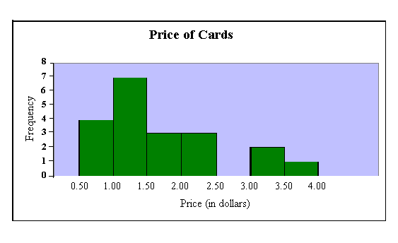

Slide 17
Girls Heights to nearest cm | Boys Heights to nearest cm
Intervals (in height) | Frequency
145 - 149
150 - 154
155 - 159
160 - 164
165 - 169
170 - 174
175 -180
Total

Slide 18
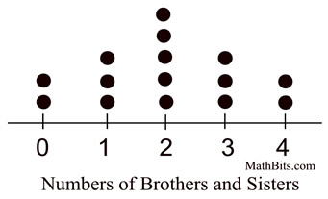
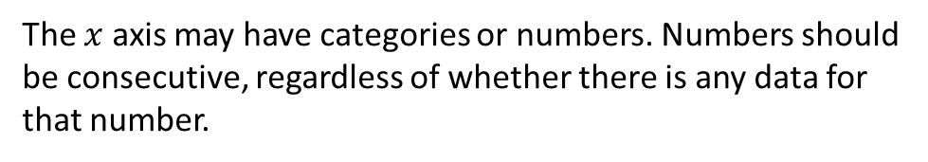
24
7
30
Title: Dot Plots
Date: 19/3/15
EQ :
Question:
Notes:
Dot plots are similar to frequency tables. They make it easier to see and interpret data.
Dots are stacked on top of each other in columns to represent the frequency (or count) of an occurrence.
The $x$ axis may have categories or numbers. Numbers should be consecutive, regardless of whether there is any data for that number.
13
5

Slide 19
Question:
Notes continued:
Pros
Dot plots can be quickly prepared for small amounts of data. No need for a frequency axis.
Offers a visual means of comparison.
Cons
You need to count to find the total number of data elements in each stack of dots.
They can be difficult to construct and interpret for data sets with lots of points.
13
5

Slide 20
Task
On Monday, students in Year 8 were asked how long it took them to eat their breakfast that morning. The results are shown below:
No. of minutes: 0 1 2 3 4 5 6 7 8 9 10 11 12
No. of students: 6 2 3 5 2 5 0 0 2 3 7 4 1
Construct a dot plot for this data.
What is the mode for this set of data?
What is the median?
Can you find the mean?
What can you say about the number of students who took 0 minutes to eat breakfast?

Slide 21
Notes Review
24, 7 ,30
Date
Title
Essential question
Notes complete
Notes complete with colour and diagrams
Questions completed
Contents page filed in
Formula page filled in

Slide 22
Homework
Review your notes and write a summary answering the essential question.

